Slide 1
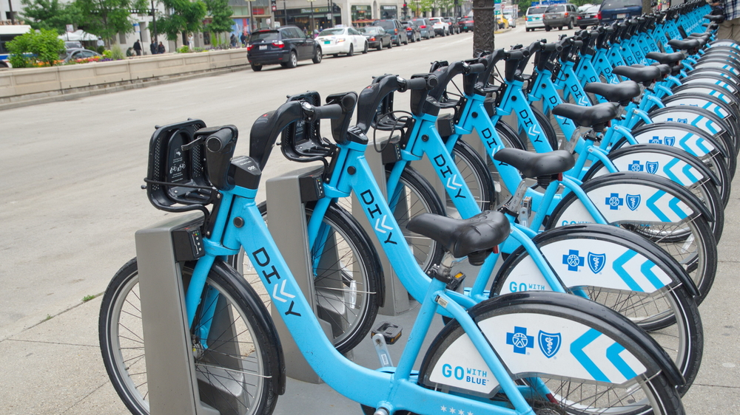
Analyzing Customer Behavior: Insights into Member vs. Casual Customer Dynamics
By Prateek
Last Updated: 23/09/2023

Slide 2

Table of Contents
Introduction
Data Collection
Data Cleaning
Data Analysis & Findings
Recommendations
Limitations/Future Scope

Slide 3

Introduction
Background Information: Cyclistic, a bike-share company based in Chicago provides bikes on rental where riders can unlock bikes from one station and dock it to any station.
Objective: Designing marketing strategies aimed at converting casual riders into annual members.
Problem Statement: How do annual members and casual riders use Cyclistic bikes differently?

Slide 4

Data Collection
Data about the customer behavior was collected from the company website as a CSV file.
The dataset included all the bike rides taken in Q1 of 2019 in Chicago.
Data Source: https://divvy-tripdata.s3.amazonaws.com/index.html
License: https://divvybikes.com/data-license-agreement

Slide 5

Data Cleaning
Data was imported in SQL for cleaning and analysis purposes.
Null values were dropped and data type for each column was specified.
New columns were added based on the calculations done on existing columns

Slide 6

Data Analysis

Slide 7
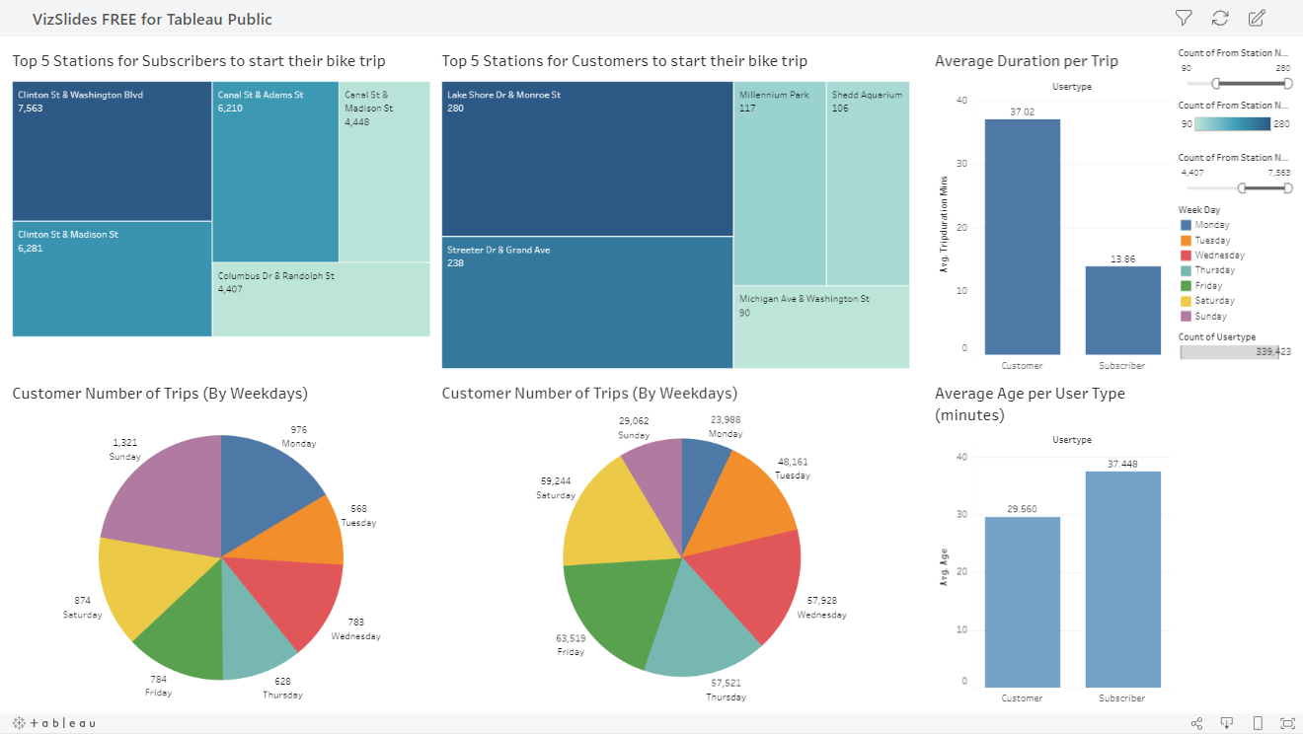

Slide 8

Findings
Average age of casual customers is 29.5 and 37.4 of members.
Casual riders on an average take 37 minutes per trip while members take 13.8 minutes per trip.
Lakeshore Dr & Monroe St and Streeter Dr & Grande Ave are top station points where casual riders begin their trips from.
Clinton St & Washington Blvd and Clinton St & Madison St are top station points where annual members begin their trips from.
Casual Customers take their most trips on Sundays and Mondays.
Annual members take their most trips on Fridays and Saturdays.

Slide 9

Recommendations
1) Targeted Marketing in 3 areas (Using Billboards, Posters, Promotional Offers, etc):
Age specific – To customers around 29 years of age
Location specific – In stations with the highest footfall
Day specific – In weekends where bike usage is the highest
2) Emphasizing how annual membership can save time and money on longer trip durations.

Slide 10

Limitations
Repeat Customers (both member and casual) could not be identified in the dataset.
The dataset included only Q1 data in 2019.
Other important problem statements like below could not be answered with this dataset:
Why would casual riders buy Cyclistic annual memberships?
How can Cyclistic use digital media to influence casual riders to become members?
Further analysis is required to create a more robust and accurate marketing program

